Slide 1


19EC786
Analog VLSI design

Slide 2
19EC786 – Analog VLSI design
Syllabus
UNIT I BASIC MOS DEVICES 9
Depletion region of PN junction - Band diagram of MOS capacitor – Accumulation, Depletion, inversion region- Large and small signal behavior of MOSFET- short channel effects in MOS transistors – weak inversion in MOS transistors- substrate current flow in MOS transistor.
UNIT II HIGH FREQUENCY CMOS AMPLIFIERS AND CURRENT MIRROR CIRCUITS 9
Common source, common drain, common gate. Differential amplifiers-Cascode amplifiers-Current amplifiers–power amplifiers- Current sources and sinks ,MOS Current Mirrors – Simple, Cascode, Wilson and Widlar current source.
UNIT III CMOS OPERATIONAL AMPLIFIER 9
Design of CMOS Op amps - Compensation of Op amps- Low voltage Op amps - Low noise Op amps Two stage MOS Operational Amplifiers with Cascode, MOS Telescopic - Cascode Operational Amplifier, MOS Folded Cascode and MOS Active Cascode Operational Amplifiers.
UNITIV COMPARATORS AND SWITCHED CAPACITOR CIRCUITS 9
Characterization of a Comparator -two-Stage Open-Loop Comparators - Improving the Performance of Open-Loop Comparators-Discrete-Time Comparators - High-Speed Comparators- Switched Capacitor Circuits – Switched Capacitor Amplifiers - Switched Capacitor Integrators
UNITV A/D AND D/A CONVERTERS 9
Characterization of D/A converters- Parallel D/A converters-extending the resolution of parallel D/A converters- Serial D/A converters- Characterization of A/D converters-Serial A/D converters- Medium and high speed A/D converters.

Slide 3
UNIT I BASIC MOS DEVICES
UNIT I BASIC MOS DEVICES
Depletion region of PN junction
Band diagram of MOS capacitor
Accumulation, Depletion, inversion region
Large and small signal behavior of MOSFET
Short channel effects in MOS transistors
Weak inversion in MOS transistors
Substrate current flow in MOS transistor.

Slide 4
UNIT I BASIC MOS DEVICES
Depletion Region of a pn Junction
The properties of reverse-biased pn junctions have an important influence on the characteristics of many integrated-circuit components. For example, reverse-biased pn junctions exist between many integrated-circuit elements and the underlying substrate, and these junctions all contribute voltage-dependent parasitic capacitances.
In addition, a number of important characteristics of active devices, such as breakdown voltage and output resistance, depend directly on the properties of the depletion region of a reverse-biased pn junction. Finally, the basic operation of the junction field-effect transistor is controlled by the width of the depletion region of a pn junction.
Assume constant doping densities of N_{D} atoms/cm3 in the n-type material and N_{A} atoms/cm3 in the p-type material.
Due to the difference in carrier concentrations in the p-type and n-type regions, there exists a region at the junction where the mobile holes and electrons have been removed, leaving the fixed acceptor and donor ions. Each acceptor atom carries a negative charge and each donor atom carries a positive charge, so that the region near the junction is one of significant space charge and resulting high electric field. This is called the depletion region or space-charge region.

Slide 5
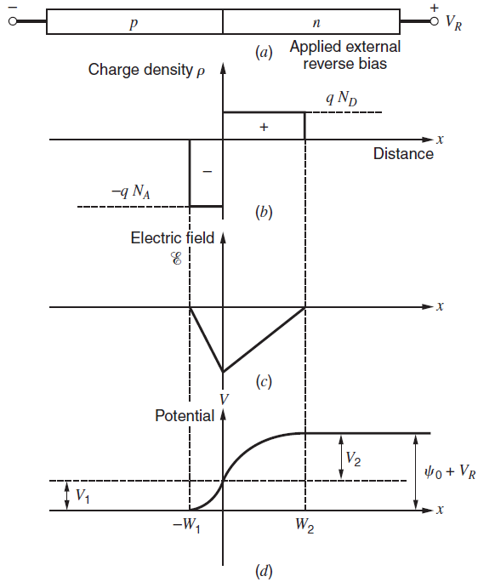
UNIT I BASIC MOS DEVICES
Depletion Region of a pn Junction
The abrupt junction
under reverse bias VR.
Schematic.
Charge density.
Electric field.
Electrostatic potential.

Slide 6



UNIT I BASIC MOS DEVICES
Depletion Region of a pn Junction
For zero applied bias, there exists a voltage ψ₀ across the junction called the built-in potential. This potential opposes the diffusion of mobile holes and electrons across the junction in equilibrium
----(1)
Where,
If the depletion region penetrates a distance W₁ into the p-type region and W₂ into the n-type region, then we require
----(2)
The total charge per unit area on either side of the junction must be equal n magnitude but opposite in sign.

Slide 7




UNIT I BASIC MOS DEVICES
Depletion Region of a pn Junction
Poisson’s equation in one dimension requires that
----(3)
----(4)
----(5)
where C1 is a constant.
However, the electric field E is given by
----(6)

Slide 8





UNIT I BASIC MOS DEVICES
Depletion Region of a pn Junction
Since there is zero electric field outside the depletion region, a boundary condition is
C₁ = -qN_{A}W₁/E
In (6), sub C₁ value,
---- (7)
Thus the dipole of charge existing at the junction gives rise to an electric field that varies linearly with distance.
Integration of equation (7) gives,
---- (8)
If the zero for potential is arbitrarily taken to be the potential of the neutral p-type region, then a second boundary condition is,
C₂ = -qN_{A}W₁²/2E
Use these in equation (8) gives
---- (9)

Slide 9

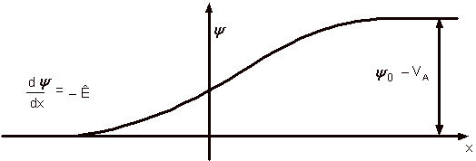


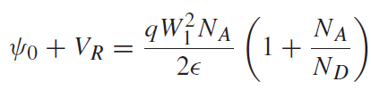
UNIT I BASIC MOS DEVICES
Depletion Region of a pn Junction
V is a potential varies with distance x,
At x=0, we define V=V₁ and equation (9) becomes,
---- (10)
If the potential difference from x = 0 to x = W₂ is V₂, then it follows that
---- (11)
Thus the total voltage across the junction is,
---- (12)
From equation (2), W₂ = W₁N_{A}/N_{D}; Sub. In Equation (12),
---- (13)

Slide 10
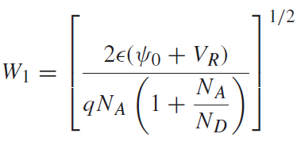
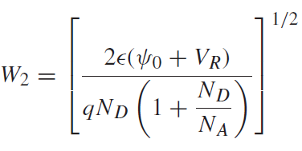
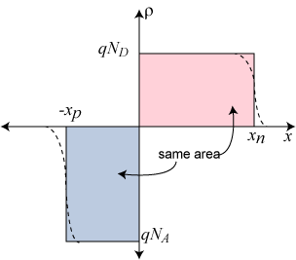
UNIT I BASIC MOS DEVICES
Depletion Region of a pn Junction
From equation (13),
The penetration of the depletion layer into the p-type region is,
---- (14)
The penetration of the depletion layer into the n-type region is,
(sub. W₁ = W₂N_{D}/N_{A}; in equation (12) and solve for W₂),
---- (15)

Slide 11
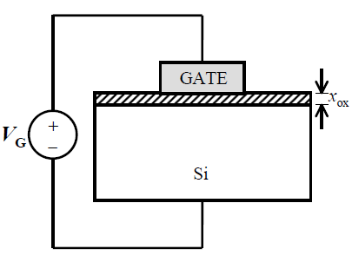
UNIT I BASIC MOS DEVICES
Band diagram of MOS capacitor
MOS Capacitor Structure
MOS capacitors and transistors in ICs today has,
Heavily doped polycrystalline Si (“poly-Si”) film as the gate electrode material
n+-type, for “n-channel” transistors (NMOS)
p+-type, for “p-channel” transistors (PMOS)
SiO2 as the gate dielectric
band gap = 9 eV
ε_{r},SiO₂ = 3.9
Si as the semiconductor material (Subtrate)
p-type, for “n-channel” transistors (NMOS)
n-type, for “p-channel” transistors (PMOS)

Slide 12
UNIT I BASIC MOS DEVICES
Band diagram of MOS capacitor
MOS Capacitor Structure
MOS capacitor is an equilibrium device i.e. when the external voltage is not applied to the device the Fermi level of metal and semiconductor are at same level.
When external voltage is applied to device it behaves according to the voltage applied with respect to flat band voltage and threshold voltage.
Flat band voltage is defined as a work function difference between the gate metal and the semiconductor when no charge is present in oxide-semiconductor interface.
Threshold voltage is defined as the minimum gate-to-source voltage required to induce or create a conducting channel. This can be divided into three types
Work Function: It is the distance between Fermi level of Metal or Semi-conductor and the Conduction Band edge (of oxide layer).
Properties of Ideal MOS Capacitor :
Work function of metal and Semi-conductor substrate is equal.
No trapped charges.
No current flows from Metal to Semi-conductor substrate.

Slide 13
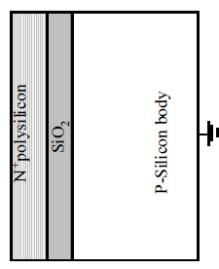
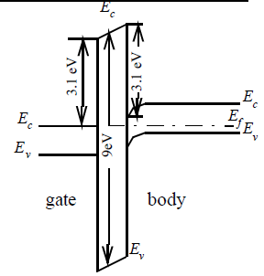
UNIT I BASIC MOS DEVICES
Band diagram of MOS capacitor
MOS Capacitor Structure
Metal
SiO₂
SC or Subs.
E_{C} of Oxide layer

Slide 14
UNIT I BASIC MOS DEVICES
Band diagram of MOS capacitor
1. Accumulation layer
In this case, applied voltage (Vg) is less than flat band voltage. Voltage applied to gate (on metal side) is negative.
When voltage is applied, MOSFET (N-Channel) no longer remain in equilibrium condition. The Fermi energy level of metal changes by charge of electron multiplied by applied voltage. Voltage applied is negative and hence rise in Fermi level of metal takes place while Fermi level of semiconductor remain constant
Voltage applied to the gate is negative hence negative charge develops near metal-oxide junction thus positively charged hole travel towards the oxide junction thus creating positive charge near the oxide-semiconductor junction.
Due to accumulation of positive charge, surface voltage is developed near oxide-semiconductor junction due to this energy band bending takes place and the value is charge of electron multiplied by surface voltage.
Energy band bending is changes in energy offset (level) of semiconductor’s band structure near junction due to space charge.

Slide 15
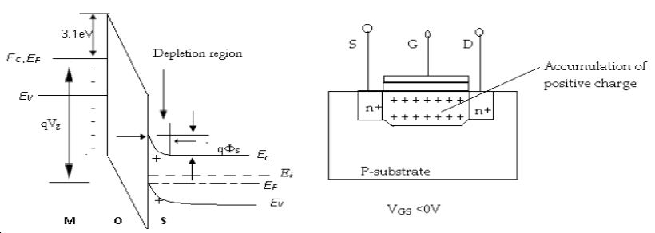

UNIT I BASIC MOS DEVICES
Band diagram of MOS capacitor
1. Accumulation layer
Energy band diagram and MOSFET internal charge distribution in accumulation region
Where,
E_{C} = conduction band energy level
E_{F} = Fermi energy level
E_{V} = valance band energy level
E_{i} = intrinsic energy level
Q = charge of electron
V_{g} =voltage applied on gate
Φ_{s} =surface voltage

Slide 16
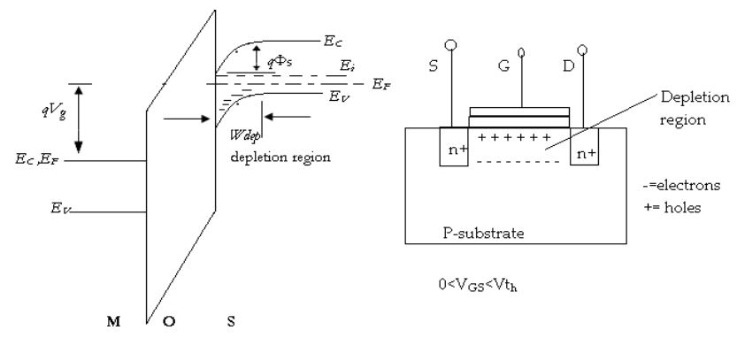
UNIT I BASIC MOS DEVICES
Band diagram of MOS capacitor
2. Depletion layer
Energy band diagram and MOSFET internal charge distribution in depletion region

Slide 17
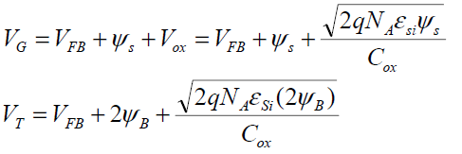
UNIT I BASIC MOS DEVICES
Band diagram of MOS capacitor
2. Depletion layer
In depletion region, voltage applied to gate is greater than flat band voltage and less than threshold voltage.
In this case, voltage applied to gate is positive hence there is fall in Fermi energy level of metal while rise in Fermi energy level of semiconductor.
Since voltage applied to positive and hence positive charge develops near metal-oxide junction thus the electrons travel towards the gate creating negative charge near oxide-semiconductor junction.
Electrons recombine with holes present near oxide creating depletion region.
Surface voltage develops in depletion region and effect of this we have energy band bending in depletion region.

Slide 18
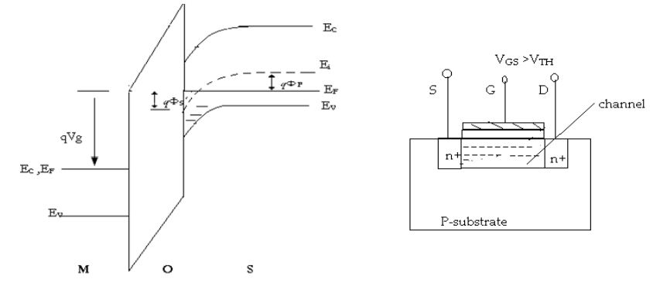
UNIT I BASIC MOS DEVICES
Band diagram of MOS capacitor
3. Inversion layer
Energy band diagram and MOSFET internal charge distribution in inversion region

Slide 19

UNIT I BASIC MOS DEVICES
Band diagram of MOS capacitor
3. Inversion layer
In inversion layer, applied voltage is greater than threshold voltage.
The reason it is called as inversion layer as the surface is inverted from p-type to n-type near the junction.
Voltage applied is very high hence Fermi level of metal goes down further.
Since voltage applied is positive to gate, electrons travel towards the gate and accumulates near semiconductor-oxide junction resulting development of surface potential. Due to surface potential energy band bending takes place.
From the diagram p type substrate near semiconductor-oxide junction has intrinsic energy level below Fermi energy level and this part of substrate behave as n-type semiconductor and part above the Fermi level behave as p-type semiconductor. This happen due to concentration of electrons exceeds concentration of holes near semiconductor-oxide junction and the event is called as surface inversion.
N-type semiconductor acts as a channel for current and current can flow through this channel on application of positive drain-source voltage.

Slide 20
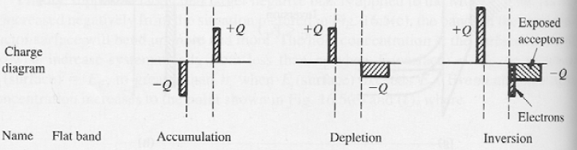
UNIT I BASIC MOS DEVICES
Band diagram of MOS capacitor
Charge Diagram – N Channel (P-Substrate)

Slide 21
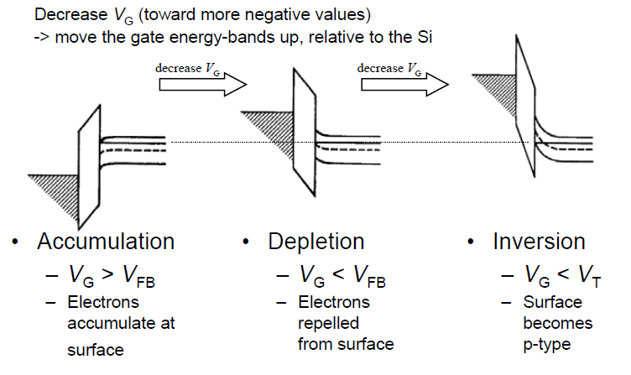
UNIT I BASIC MOS DEVICES
Band diagram of MOS capacitor
P-Channel (N-Substrate)

Slide 22
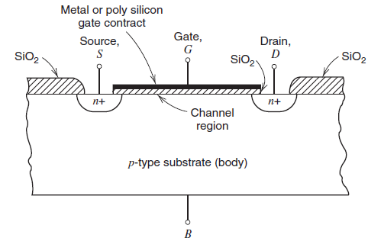
UNIT I BASIC MOS DEVICES
Large-Signal Behavior of MOSFET
MOSFET allows,
High density and
Low power dissipation.
Advantages of BJT,
High trans-conductance per unit bias current
It forces the associated analog circuits to use MOS-compatible technologies.
Typical enhancement-mode NMOS structure.

Slide 23
UNIT I BASIC MOS DEVICES
Large-Signal Behavior of MOSFET
Heavily doped n-type source and drain regions are fabricated in a p-type substrate (often called the body).
A thin layer of silicon dioxide is grown over the substrate material.
A conductive gate material (metal or polycrystalline silicon) covers the oxide between source and drain.
In operation, the gate-source voltage modifies the conductance of the region under the gate, allowing the gate voltage to control the current flowing between source and drain.
The enhancement-mode NMOS device of Fig. shows significant conduction between source and drain only when an n-type channel exists under the gate.
This observation is the origin of the n-channel designation. The term enhancement mode refers to the fact that no conduction occurs for V_{GS} = 0.
Thus, the channel must be enhanced to cause conduction.MOS devices can also be made by using an n-type substrate with a p-type conducting channel.
Such devices are called enhancement-mode p-channel MOS (PMOS) transistors.
In complementary MOS (CMOS) technology, both device types are present.
The junctions are formed between the n-type source and drain regions and the p-type substrate, resulting in an extremely high resistance (about 10¹² Ω) between drain and source when the device is off.

Slide 24
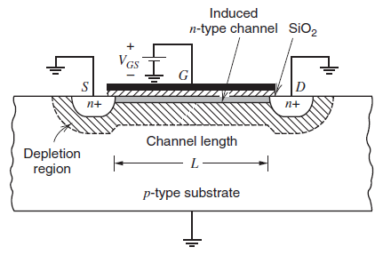

UNIT I BASIC MOS DEVICES
Large-Signal Behavior of MOSFET
Now consider the substrate, source, and drain grounded with a positive voltage V_{GS} applied to the gate.
The gate and substrate then form the plates of a capacitor with the SiO₂ as a dielectric. Positive charge accumulates on the gate and negative charge in the substrate.
Initially, the negative charge in the p-type substrate is manifested by the creation of a depletion region
NMOS device with positive V_{GS} applied, showing depletion regions and the induced channel.
The depletion-layer width ‘X’ under the oxide is
----(1)
Where,
φ is the potential in the depletion layer at the oxide-silicon interface
N_{A} is the doping density of the p-type substrate in atoms/cm3,
ε is the permittivity of the silicon.

Slide 25



UNIT I BASIC MOS DEVICES
Large-Signal Behavior of MOSFET
The charge per area in this depletion region is
----(2)
When the surface potential in the silicon reaches a critical value equal to twice the Fermi
level φ_{f} , a phenomenon known as inversion occurs. The Fermi level φ_{f} is defined as
----(3)
where k is Boltzmann’s constant. Also, n_{i} is the intrinsic carrier concentration,
Where,
Eg is the band gap of silicon at T = 0◦K
Nc is the density of allowed states near the edge of the conduction band
Nv is the density of allowed states near the edge of the valence band

Slide 26


UNIT I BASIC MOS DEVICES
Large-Signal Behavior of MOSFET
The Fermi level φ_{f} is usually about 0.3 V. After the potential in the silicon reaches 2φ_{f} , further increases in gate voltage produce no further changes in the depletion-layer width but instead induce a thin layer of electrons in the depletion layer at the surface of the silicon directly under the oxide.
Inversion produces a continuous n-type region with the source and drain regions and forms the conducting channel between source and drain.
The conductivity of this channel can be modulated by increases or decreases in the gate-source voltage.
In the presence of an inversion layer, and without substrate bias, the depletion region contains a fixed charge density
----(4)
If a substrate bias voltage V_{SB} (positive for n-channel devices) is applied between the source and substrate, the potential required to produce inversion becomes (2φ_{f} + V_{SB}), and the charge density stored in the depletion region
----(5)

Slide 27


UNIT I BASIC MOS DEVICES
Large-Signal Behavior of MOSFET
The gate-source voltage V_{GS} required to produce an inversion layer is called the threshold
voltage V_{t}.
First, a voltage [2φ_{f} + (Q_{b}/C_{ox})] is required to sustain the depletion-layer charge Q_{b}, where C_{ox} is the gate oxide capacitance per unit area.
Second, a work-function difference φ_{ms} exists between the gate metal and the silicon.
Third, positive charge density Q_{ss} always exists in the oxide at the silicon interface. This charge is caused by crystal discontinuities at the Si-SiO₂ interface and must be compensated by a gate-source voltage contribution of −Q_{ss}/C_{ox}.
----(6)
where ε_{ox} and t_{ox} are the permittivity and the thickness of the oxide, respectively.
A typical value of Cox = 3.45 fF/μm² for t_{ox} = 100 angstroms.

Slide 28
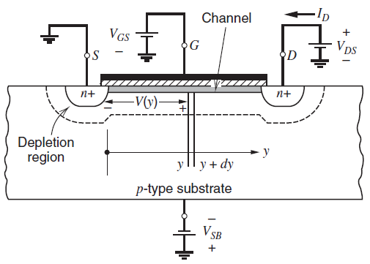
UNIT I BASIC MOS DEVICES
Large-Signal Behavior of MOSFET
In this analysis, the source is assumed grounded and bias voltages V_{GS}, V_{DS}, and V_{SB} are applied as shown in Fig.
If V_{GS} > V_{t} , inversion occurs and a conducting channel exists.
The channel conductivity is determined by the vertical electric field, which is controlled by the value of (V_{GS} − V_{t} ).
NMOS device with bias voltages applied.
If V_{DS} = 0, the current ID that flows from drain to source is zero because the horizontal electric field is zero.
Nonzero V_{DS} produces a horizontal electric field and causes current I_{D} to flow.
Positive voltage V_{DS} causes the reverse bias from the drain to the substrate to be larger than from the source to substrate, and thus the widest depletion region exists at the drain.

Slide 29



UNIT I BASIC MOS DEVICES
Large-Signal Behavior of MOSFET
The drain current I_{D} is
----(7)
Where,
dQ is the incremental channel charge at a distance y from the source in an incremental length dy of the channel,
dt is the time required for this charge to cross length dy.
The charge dQ is
----(8)
Q_{I} is the induced electron charge per unit area of the channel.
At a distance y along the channel, the voltage with respect to the source is V(y) and the gate-to-channel voltage at that point is V_{GS} − V(y). We assume this voltage exceeds the threshold voltage V_{t}.
Thus the induced electron charge per unit area in the channel is
----(9)

Slide 30




UNIT I BASIC MOS DEVICES
Large-Signal Behavior of MOSFET
where v_{d} is the electron drift velocity at a distance y from the source.
----(10)
From (7), (8) and (10),
----(11)
The drift velocity is determined by the horizontal electric field. When the horizontal electric field E(y) is small, the drift velocity is proportional to the field
----(12)
μ_{n} is the average electron mobility in the channel.
The electric field E(y) is
----(13)
where dV is the incremental voltage drop along the length of channel dy at a distance y from the source.

Slide 31

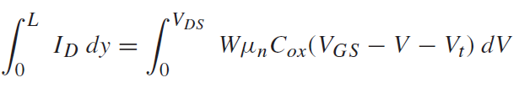


UNIT I BASIC MOS DEVICES
Large-Signal Behavior of MOSFET
Sub., equation (9), (12) & (13) in (11),
----(14)
Integrating the above
----(15)
Non-Saturation Region
----(16)
where

Slide 32
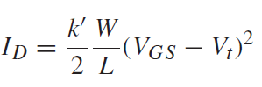
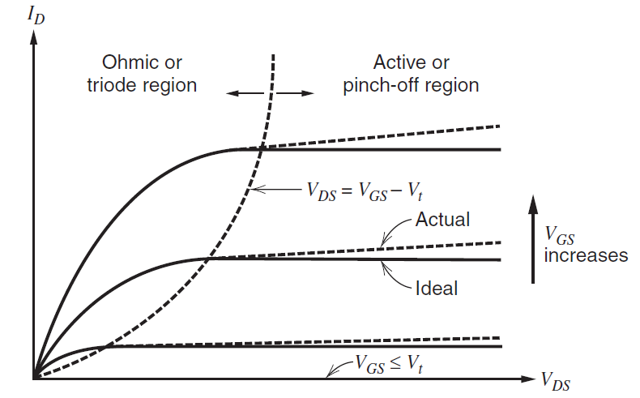
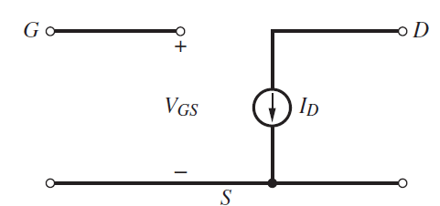
UNIT I BASIC MOS DEVICES
Large-Signal Behavior of MOSFET
As the value of VDS is increased, the induced conducting channel narrows at the drain end and Q_{I} at the drain end approaches zero as V_{DS} approaches (V_{GS} − V_{t}).
That is, the channel is no longer connected to the drain when V_{DS} >V_{GS}−V_{t}.
This phenomenon is called pinch-off.
Therefore, when V_{DS} > V_{GS} − V_{t},
----(17)
Saturation Region
NMOS device characteristics.
Large-signal model for the NMOS transistor.

Slide 33


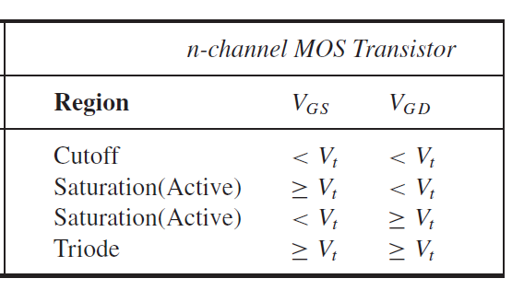
UNIT I BASIC MOS DEVICES
Large-Signal Behavior of MOSFET
Including the effect of channel-length modulation,
----(18)
Channel length modulation is the reciprocal of the Early voltage,
Operating regions of n-channel MOS transistors.

Slide 34
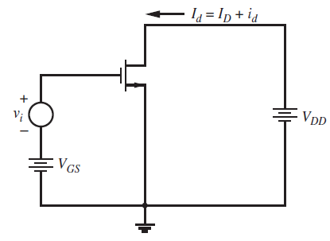
UNIT I BASIC MOS DEVICES
Small-Signal Behavior of MOSFET
To simplify the calculation of circuit gain and terminal impedances, small-signal models can be used.
Schematic of an MOS transistor with biasing
Consider the MOS transistor in Fig. with bias voltages V_{GS} and V_{DD} applied as shown.
These bias voltages produce quiescent drain current I_{D}.
If V_{GS} > V_{t} and V_{DD} > (V_{GS} − V_{t} ), the device operates in the saturation or active region.
A small-signal input voltage v_{i} is applied in series with V_{GS} and produces a small variation in drain current i_{d}.
The total value of the drain current is Id = (I_{D} + i_{d}).

Slide 35
UNIT I BASIC MOS DEVICES
Small-Signal Behavior of MOSFET
Transconductance
Intrinsic Gate-Source and Gate-Drain Capacitance
Input Resistance
Output Resistance
Basic Small-Signal Model of the MOS Transistor
Body Transconductance
Parasitic Elements in the Small-Signal Model
MOS Transistor Frequency Response

Slide 36






UNIT I BASIC MOS DEVICES
Small-Signal Behavior of MOSFET
Transconductance
Assuming square-law operation, the transconductance from the gate can be determined from equation (18) by differentiating
----(1)
----(2)
Saturation Region
----(3)
Using equation (2) and (3),
----(4)
Vov – Overdrive Voltage
One of the key challenges in MOS analog circuit design is designing high-quality analog circuits with a low transconductance-to-current ratio.

Slide 37




UNIT I BASIC MOS DEVICES
Small-Signal Behavior of MOSFET
Transconductance – Drain Current
Equation (2) is valid for small-signal analysis. To determine the limitation on the use of small-signal analysis, the change in the drain current resulting from a change in the gate-source voltage will be derived from a large-signal standpoint.
The total drain current in Fig. can be calculated using (3) as (small signal V_{i} is applied)
----(5)
In (5) => a=(V_{gs}-V_{t}); b=v_{i}
Sub. Equation (3) in (5),
----(6)
Rearranging Equation (6)
----(7)
If the magnitude of the small-signal input |vi| is much less than twice the overdrive, then 2nd term will be <<1,
----(8)

Slide 38

UNIT I BASIC MOS DEVICES
Small-Signal Behavior of MOSFET
Intrinsic Gate-Source and Gate-Drain Capacitance
If C_{ox} is the oxide capacitance per unit area from gate to channel, then the total capacitance under the gate is C_{ox}WL.
This capacitance is intrinsic to the device operation and models the gate control of the channel conductance.
In the triode region of device operation, the channel exists continuously from source to drain, and the gate-channel capacitance is usually lumped into two equal parts at the drain and source with
----(1)
In the saturation or active region, however, the channel pinches off before reaching the drain, and the drain voltage exerts little influence on either the channel or the gate charge.
C_{gd} = 0
----(2)

Slide 39





UNIT I BASIC MOS DEVICES
Small-Signal Behavior of MOSFET
Intrinsic Gate-Source and Gate-Drain Capacitance
To calculate the value of the intrinsic part of C_{gs} in the saturation or active region, we must calculate the total charge Q_{T} stored in the channel.
This calculation can be carried out by substituting Q_{I}(y) into dQ and integrating to obtain
----(3)
----(4)
Sub. (4) in (3), then,
----(4)
We know that,
----(5)
Sub. (5) for dy in (4), then,
----(6)

Slide 40





UNIT I BASIC MOS DEVICES
Small-Signal Behavior of MOSFET
Intrinsic Gate-Source and Gate-Drain Capacitance
----(7)
----(8)
Integrating (6) and Use (7) & (8), then,
----(9)
Therefore, in the saturation or active region,
----(10)

Slide 41
UNIT I BASIC MOS DEVICES
Small-Signal Behavior of MOSFET
Input Resistance
The gate of an MOS transistor is insulated from the channel by the SiO2 dielectric.
As a result, the low-frequency gate current is essentially zero and the input resistance is essentially infinite.
This characteristic is important in some circuits such as sample-and-hold amplifiers, where the gate of an MOS transistor can be connected to a capacitor to sense the voltage on the capacitor without leaking away the charge that causes that voltage.

Slide 42

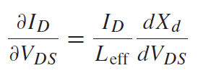


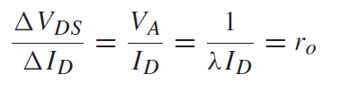
UNIT I BASIC MOS DEVICES
Small-Signal Behavior of MOSFET
Output Resistance
Increasing drain-source voltage in an n-channel MOS transistor increases the width of the depletion region around the drain and reduces the effective channel length of the device in the saturation or active region.
This effect is called channel length modulation and causes the drain current to increase when the drain-source voltage is increased.
From that treatment, we can calculate the change in the drain current ΔI_{D} arising from changes in the drain-source voltage ΔV_{DS} as,
----(1)
Use the following in (1)
Where,
V_{A} is the Early voltage,
λ is the channel-length modulation
I_{D} is the drain current
r_{o} is the small-signal output resistance of the transistor.
----(2)

Slide 43
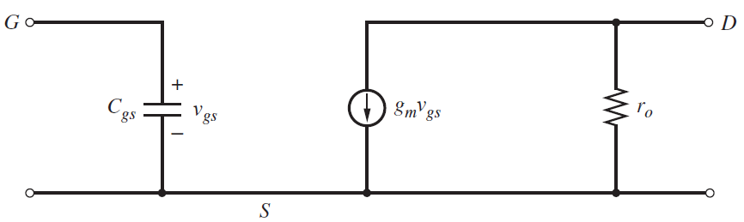
UNIT I BASIC MOS DEVICES
Small-Signal Behavior of MOSFET
Basic Small-Signal Model of the MOS Transistor
This model was derived for n-channel transistors in the saturation or active region and is called the hybrid-π model.
When the gate-source voltage is increased, the model predicts that the incremental current i_{d} flowing from drain to source increases.
Since the dc drain current I_{D} also flows from drain to source in an n-channel transistor, increasing the gate source voltage also increases the total drain current I_{d}.
This result is reasonable physically because increasing the gate-source voltage in an n-channel transistor increases the channel conductivity and drain current.
The model shown in Fig. is also valid for p-channel devices.
The current flows in a direction opposite to the dc drain current when the gate-source voltage increases, reducing the total drain current I_{d}.

Slide 44
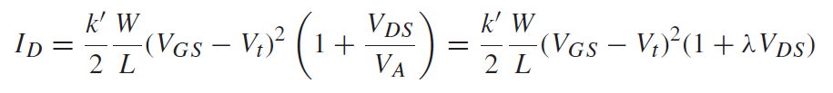
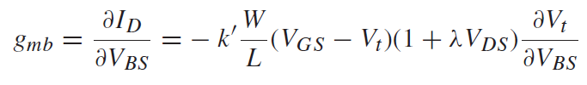
UNIT I BASIC MOS DEVICES
Small-Signal Behavior of MOSFET
Body Transconductance
The drain current is a function of both the gate-source and body-source voltages.
On the one hand, the gate-source voltage controls the vertical electric field, which controls the channel conductivity and therefore the drain current.
On the other hand, the body-source voltage changes the threshold, which changes the drain current when the gate-source voltage is fixed.
The substrate acting as a second gate and is called the body effect.
The body of an MOS transistor is connected to a constant power-supply voltage.
Therefore, when the body-source voltage is not constant, two transconductance terms are required to model MOS transistors: one associated with the main GATE and the other associated with the BODY or second gate.
----(1)
----(2)

Slide 45




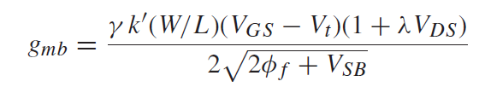
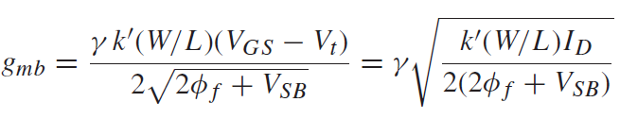

UNIT I BASIC MOS DEVICES
Small-Signal Behavior of MOSFET
We know that,
Body Transconductance
----(3)
----(4)
χ is the rate of change of threshold voltage with body bias voltage
Sub (3) in (4),
----(5)
Sub (4) in (2), we get,
----(6)
The factor χ is typically in the range 0.1 to 0.3; therefore, the transconductance from the main gate is typically a factor of about 3 to 10 times larger than the transconductance from the body or second gate.
----(5)

Slide 46
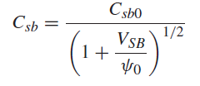
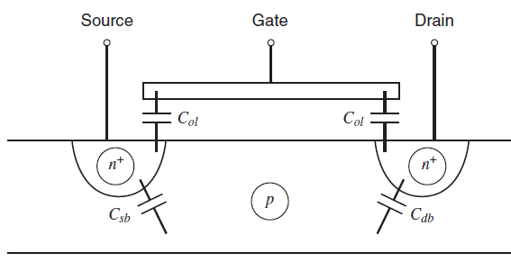

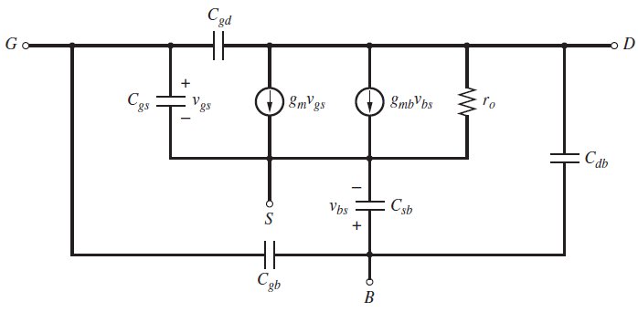
UNIT I BASIC MOS DEVICES
Small-Signal Behavior of MOSFET
Parasitic Elements in the Small-Signal Model
Cross section of an n-channel MOS transistor
Small-signal MOS transistor equivalent circuit.
These parasitic resistances have an inverse dependence on channel width W.

Slide 47
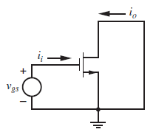
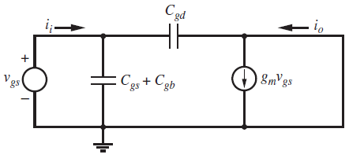
UNIT I BASIC MOS DEVICES
Small-Signal Behavior of MOSFET
MOS Transistor Frequency Response
The frequency capability of an MOS transistor is usually specified by finding the transition frequency f_{T}.
For an MOS transistor, f_{T} is defined as the frequency where the magnitude of the short-circuit, common-source current gain falls to unity.
Although the dc gate current of an MOS transistor is essentially zero, the high-frequency behavior of the transistor is controlled by the capacitive elements in the small-signal model, which cause the gate current to increase as frequency increases.
AC schematic of an MOS transistor
Small signal equivalent of an MOS transistor

Slide 48




UNIT I BASIC MOS DEVICES
Small-Signal Behavior of MOSFET
MOS Transistor Frequency Response
Since v_{sb} = v_{ds} = 0, g_{mb}, r_{o}, C_{sb}, and C_{db} have no effect on the calculation and are ignored.
The small-signal input current i_{i} is
----(1)
If the current fed forward through C_{gd} is neglected,
----(2)
From (1) and (2), we get,
----(3)
To find the frequency response, we set s = jω. Then
----(4)

Slide 49





UNIT I BASIC MOS DEVICES
Small-Signal Behavior of MOSFET
MOS Transistor Frequency Response
The magnitude of the small-signal current gain is unity when
----(5)
Therefore,
----(6)
We know that,
----(7)
Assume the intrinsic device capacitance C_{gs} is much greater than (C_{gb} + C_{gd}) and sub. above g_{m} and C_{gs} in (6),
----(8)

Slide 50
UNIT I BASIC MOS DEVICES
Short-Channel Effects in MOS Transistors
The evolution of integrated-circuit processing techniques has led to continuing reductions in both the Length (L) and Width (W) of the active devices..
In that reducing dimensions increases the number of devices and circuits that can be processed at one time on a given wafer.
A second benefit has been that the frequency capability of the active devices continues to increase, as intrinsic f_{T} values increase with smaller dimensions while parasitic capacitances decrease.
Velocity Saturation from the Horizontal Field
Transconductance and Transition Frequency
Mobility Degradation from the Vertical Field

Slide 51
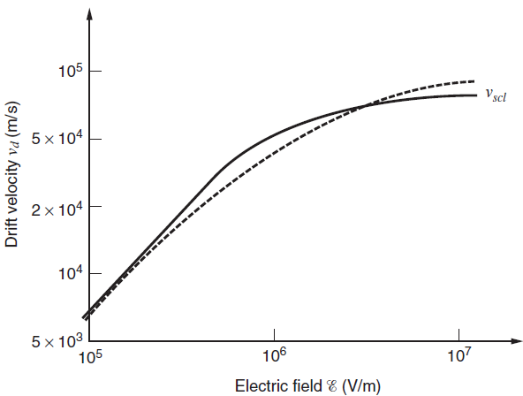


UNIT I BASIC MOS DEVICES
Short-Channel Effects in MOS Transistors
Velocity Saturation from the Horizontal Field
When an MOS transistor operates in the triode region, the average horizontal electric field along the channel is V_{DS}/L..
When V_{DS} is small and/or L is large, the horizontal field is low, and the linear relation between carrier velocity and field. (V_{d}=μ_{n}E)
At high fields, however, the carrier velocities approach the thermal velocities, and subsequently the slope of the carrier velocity decreases with increasing field.
While the velocity at low field values is proportional to the field, the velocity at high field values approaches a constant called the scattering-limited velocity vscl.
----(1)

Slide 52



UNIT I BASIC MOS DEVICES
Short-Channel Effects in MOS Transistors
Velocity Saturation from the Horizontal Field
We know that,
----(2)
----(3)
Sub. (2) and (3) in (1), then,
----(4)
We know that,
----(5)
Integrating (4) and use the relation (5),
----(6)
----(7)
Eqn. (7), gives the drain current in the
triode region without velocity saturation.

Slide 53
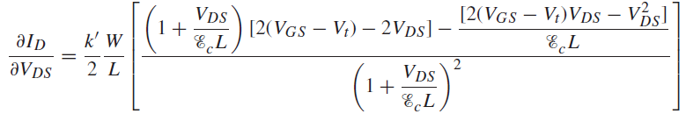



UNIT I BASIC MOS DEVICES
Short-Channel Effects in MOS Transistors
Velocity Saturation from the Horizontal Field
Let V_{DS}(act) represents
The maximum value of V_{DS} for which the transistor operates in the triode region, which is equivalent to
The minimum value of V_{DS} for which the transistor operates in the active region. In the active region.
The current should be independent of V_{DS} because channel-length modulation is not included.
----(8)
----(9)
----(10)

Slide 54




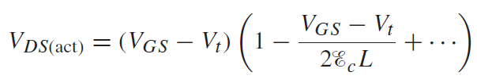



UNIT I BASIC MOS DEVICES
Short-Channel Effects in MOS Transistors
Velocity Saturation from the Horizontal Field
----(11)
----(12)
Then Taylor series is,
From (12),
----(13)
Sub. (13) in (7),
----(14)
Eqn. (7) is I_{D} with Velocity Saturation.

Slide 55
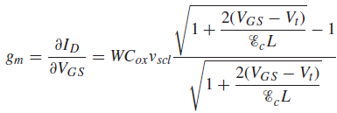
UNIT I BASIC MOS DEVICES
Short-Channel Effects in MOS Transistors
Transconductance and Transition Frequency
The values of all small-signal parameters can change significantly in the presence of short channel effects.
One of the most important changes is to the transconductance.
We know that,
----(1)
----(2)
Sub. (2) in (1), and calculating ∂I_{D}/∂V_{GS} gives,
----(3)

Slide 56



UNIT I BASIC MOS DEVICES
Short-Channel Effects in MOS Transistors
Transconductance and Transition Frequency
To determine g_{m} without velocity saturation, let Ec →∞ and x = (V_{GS} − V_{t} )/(E_{c}L) in (3),
----(4)
On the other hand, letting E_{c} → 0 to determine g_{m} when the velocity is saturated gives in (3),
----(5)
One reason the change in transconductance caused by velocity saturation is important is because it affects the transition frequency f_{T} .
We know that,
----(6)
Assuming that C_{gs} >> C_{gb} + C_{gd}, then (6) becomes,
Velocity saturation reduces the speed improvement that can be achieved through reductions in the minimum channel length.
----(7)

Slide 57

UNIT I BASIC MOS DEVICES
Short-Channel Effects in MOS Transistors
Mobility Degradation from the Vertical Field
In a MOSFET,
Horizontal field due to the V_{DS} along the Channel.
A vertical field originating from the gate voltage V_{GS} also exists and influences carrier velocity
The vertical field at any point in the channel depends on the gate-channel voltage.
Since the gate-channel voltage is not constant from the source to the drain, the effect of the vertical field on mobility should be included.
----(8)
μ_{n} is the mobility with zero vertical field, and θ is inversely proportional to the oxide thickness.

Slide 58
UNIT I BASIC MOS DEVICES
Weak Inversion in MOS Transistors
The normal region of operation for which a well-defined conducting channel exists under the gate.
In this region of strong inversion, changes in the gate-source voltage are assumed to cause only changes in the channel charge and not in the depletion-region charge.
In contrast, for gate-source voltages less than the extrapolated threshold voltage V_{t} but high enough to create a depletion region at the surface of the silicon, the device operates in weak inversion.
In the weak-inversion region, the channel charge is much less than the charge in the depletion region, and the drain current arising from the drift of majority carriers is negligible.
However, the total drain current in weak inversion is larger than that caused by drift because a gradient in minority-carrier concentration causes a diffusion current to flow.
Drain Current in Weak Inversion
Transconductance and Transition Frequency
Substrate Current Flow

Slide 59



UNIT I BASIC MOS DEVICES
Weak Inversion in MOS Transistors
Drain Current in Weak Inversion
Assume that the source and the body are both grounded; V_{DS} > 0.
Then increasing the gate-source voltage increases the surface potential ψ_{s}, which tends to reduce the reverse bias across the source-substrate junction and to exponentially increase the concentration of electrons in the p-type substrate at the source n_{p}(0).
----(1)
where n_{po} is the equilibrium concentration of electrons in the substrate (base).
The concentration of electrons in the substrate at the drain n_{p}(L) is
----(2)
The drain current due to the diffusion of electrons in the substrate is
----(3)
Where,
D_{n} is the diffusion constant for electrons
A is the cross-sectional area (A=WX)

Slide 60


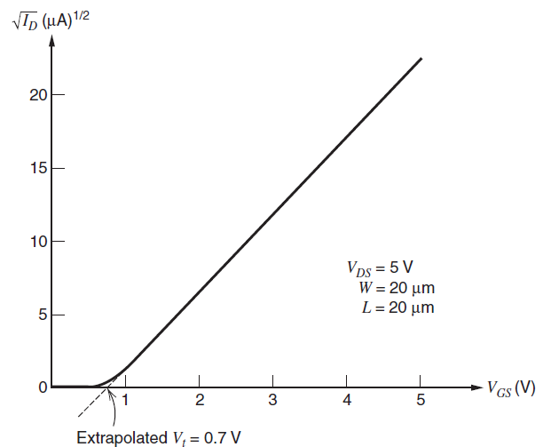
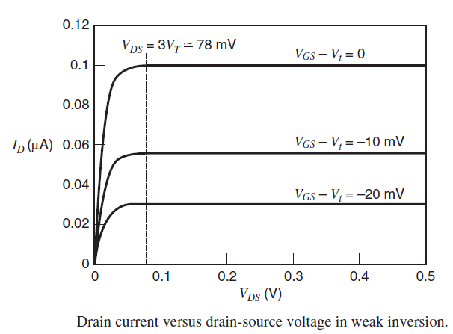
UNIT I BASIC MOS DEVICES
Weak Inversion in MOS Transistors
Drain Current in Weak Inversion
Sub. (1) & (2) in (3),
----(4)
----(5)
Weak Inversion

Slide 61



UNIT I BASIC MOS DEVICES
Weak Inversion in MOS Transistors
Transconductance and Transition Frequency in Weak Inversion
From (5), Calculating ∂I_{D}/∂V_{GS}
----(6)
Where, 1/n = Cox/(Cjs + Cox).
The ratio of the transconductance to the current of an MOS transistor in weak inversion is,
----(7)
The ratio of transconductance to current is inversely proportional to the overdrive.
Therefore, as the overdrive approaches zero, this ratio becomes infinite.
However, (8) is valid only when the transistor operates in strong inversion.
We Know that,
----(8)

Slide 62

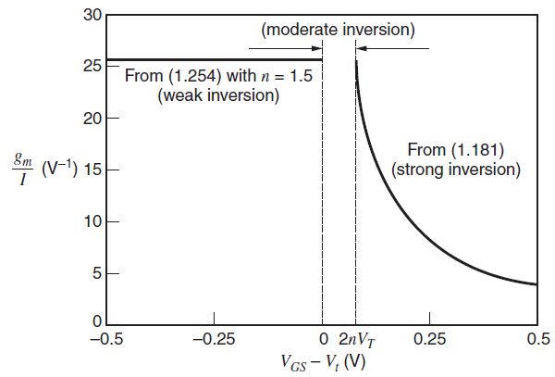
UNIT I BASIC MOS DEVICES
Weak Inversion in MOS Transistors
Transconductance and Transition Frequency in Weak Inversion
From (7) & (8),
----(9)

Slide 63
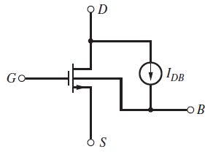

UNIT I BASIC MOS DEVICES
Weak Inversion in MOS Transistors
Substrate Current Flow in MOS Transistors
As the reverse-bias voltages on the device are increased, carriers traversing the
depletion regions gain sufficient energy to create new electron-hole pairs in lattice collisions
by a process known as impact ionization
Impact ionization also occurs in MOS transistors but has a significantly different effect on the device characteristics. This difference is because the channel electrons (for theNMOScase) create electron-hole pairs in lattice collisions in the drain depletion region, and some of the resulting holes then flow to the substrate, creating a substrate current.
The magnitude of this substrate current depends on the voltage across the drain depletion region and also on the drain current.
Impact ionization in an MOSFET by a drain-substrate current generator.
where ,
K₁ and K₂ are process-dependent parameters
V_{DS}(act) is the minimum value of V_{DS} for which the transistor operates in the active region
----(10)

Slide 64
UNIT I BASIC MOS DEVICES
Weak Inversion in MOS Transistors
Substrate Current Flow in MOS Transistors
The drain-substrate small-signal conductance is
----(11)
Where,
the gate and the source are assumed to be held at fixed potentials.

Slide 65
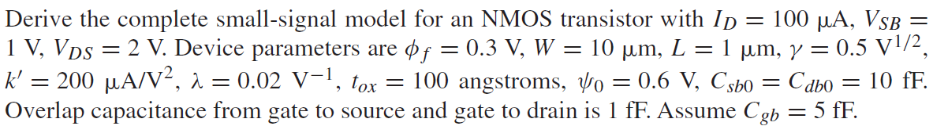
UNIT I BASIC MOS DEVICES
Problems

Slide 66
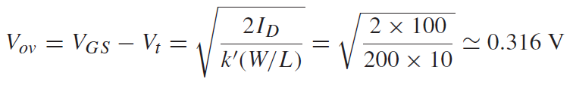

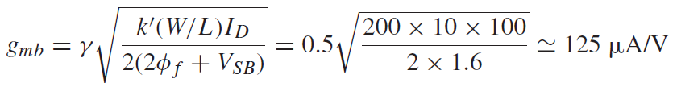
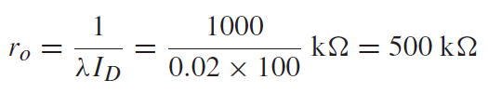
UNIT I BASIC MOS DEVICES
Problems

Slide 67

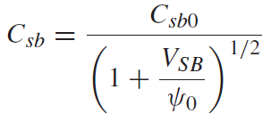
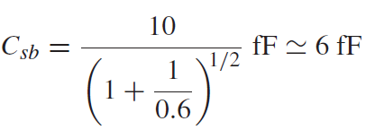





UNIT I BASIC MOS DEVICES
Problems

Slide 68







UNIT I BASIC MOS DEVICES
Problems

Slide 69

UNIT I BASIC MOS DEVICES
Problems

Slide 70
UNIT I BASIC MOS DEVICES
Problems

Slide 71







UNIT I BASIC MOS DEVICES
Problems

Slide 72



UNIT I BASIC MOS DEVICES
Problems

Slide 73
https://www.pveducation.org/pvcdrom/pn-junctions/solving-for-depletion-region
https://www.ques10.com/p/4582/draw-and-explain-energy-band-diagram-of-mos-capa-2/?

